Slide 1

SRM INSTITUTE OF SCIENCE AND TECHNOLOGY
Ramapuram , Chennai – 600 089
DEPARTMENT OF COMPUTER SCIENCE AND ENGINEERING
21CSC305P/ MACHINE LEARNING
LOAN PROCESSING AND RISK ASSESSMENT
BATCH NUMBER :2
Team Members | Supervisor
Mutheeshwari J(RA2411003020194) Nikitha S(RA2411003020202) Sandra PV(RA2411003020223) | NAME: Dr R Sujeetha AP/CSE

Slide 2
Agenda
Abstract
Scope and Motivation
Introduction
Literature Survey
Problem Statement
Objective
Proposed Work
Architecture Diagram
Dataset and Feature Engineering
Modules
Algorithm
Implementation and Demo
Results and Discussion – Comparison with Existing Work
Conclusion
Future Work
References

Slide 3
ABSTRACT
Loan approval is a risk-sensitive decision that is slow and inconsistent when done manually. This project builds an automated Loan Approval and Risk Assessment system using machine learning. A synthetic dataset of 5,000 applications with 11 input features is used to benchmark Logistic Regression and Random Forest, and the Random Forest (500 trees) is deployed as the production model. It achieves 95.50% accuracy, 96.16% recall and 98.32% ROC-AUC on 1,000 held-out records, and credit history and applicant income are the strongest predictors. The model is combined with a 45% FOIR underwriting rule and served through a FastAPI backend and a web portal (“lendr”) that returns an instant approval decision, risk score and explanation.

Slide 4
Scope and Motivation
Banks receive a large number of loan applications. Manual review is slow, inconsistent and costly.
A wrongly approved loan increases non-performing assets (NPAs).
A wrongly rejected loan loses a good customer.
The project predicts eligibility automatically from applicant details.
It assesses risk with a FOIR-based underwriting check.
It provides a web portal where applicants assess loans and track their applications.
Limits
The system supports decisions and does not replace them.
Final approval still depends on document verification and the institution’s lending policy.
The model is trained on a synthetic dataset.
Results should be validated on real data before any real-world use.

Slide 5
Introduction
Lending is the main revenue source of banks, so separating creditworthy applicants from risky ones is critical. Machine learning learns patterns from past applications and predicts approval for new ones, capturing links between income, loan amount and credit history that fixed rules miss. This project trains two models, Logistic Regression as a baseline and Random Forest, and deploys the better one. It is built as a full-stack application: a FastAPI backend serves the model, and a single-page web portal (HTML, CSS and JavaScript) lets users assess a loan, view EMI and eligibility, track applications and see model performance.

Slide 6
Literature Survey (1/2)
S.No. | Title of the Paper | Year | Methodology Used | Inferences
1 | Random Forests (Breiman) | 2001 | Ensemble of decision trees on bootstrap samples with random feature selection | Reduces variance and over-fitting; gives feature importance
2 | Scikit-learn: Machine Learning in Python (Pedregosa et al.) | 2011 | Python library for classifiers, pipelines, cross-validation and tuning | Standard toolkit used to build and evaluate the models
3 | Statistical Classification Methods in Consumer Credit Scoring: A Review (Hand & Henley) | 1997 | Review of discriminant analysis, logistic regression and decision trees | Ranking applicants by risk and misclassification cost matter
4 | Consumer credit-risk models via machine-learning algorithms (Khandani, Kim & Lo) | 2010 | Tree-based machine learning on large bank data | ML forecasts delinquency better than conventional scoring
5 | Benchmarking classification algorithms for credit scoring (Lessmann et al.) | 2015 | Compared many classifiers on several credit datasets | Ensemble methods rank among the best

Slide 7
Literature Survey (2/2)
S.No. | Title of the Paper | Year | Methodology Used | Inferences
6 | XGBoost: A Scalable Tree Boosting System (Chen & Guestrin) | 2016 | Scalable gradient-boosted tree system | Strong baseline for tabular data such as loan records
7 | SMOTE: Synthetic Minority Over-sampling Technique (Chawla et al.) | 2002 | Creates synthetic samples of the minority class | Helps with imbalanced approve / reject data
8 | An introduction to ROC analysis (Fawcett) | 2006 | ROC curves and AUC for classifier evaluation | Threshold-independent measure of model quality
9 | A survey of credit and behavioural scoring (Thomas) | 2000 | Survey of scoring techniques and issues | Motivates monitoring and periodic retraining
10 | The Elements of Statistical Learning (Hastie, Tibshirani & Friedman) | 2009 | Cross-validation, bias-variance trade-off, ensembles | Foundation for evaluation and tuning

Slide 8
Problem Statement
Traditional loan processing relies on manual verification of applicant details, income and credit history. It is time-consuming, depends on the experience of individual officers and can lead to inconsistent or biased decisions. Banks also struggle to identify high-risk applicants early, and every wrongly approved loan increases their exposure to default. An automated, data-driven system is needed that predicts whether a loan should be approved, quantifies the risk, responds in real time and stays transparent enough for loan officers to trust.

Slide 9
Objective
To build an automated loan approval and risk assessment system using machine learning.
To automate eligibility prediction from applicant data.
To compute risk measures (EMI, DTI/FOIR, Loan-to-Income) and apply a 45% FOIR underwriting rule.
To benchmark Logistic Regression and Random Forest and deploy the best model.
To evaluate with accuracy, precision, recall, F1, ROC-AUC, confusion matrix and feature importance.
To expose the model through a FastAPI service (/predict, /model-performance).
To provide a web portal for applicant assessment and model performance.
To reduce processing time and make decisions consistent.

Slide 10
Proposed Work
The proposed system takes applicant details such as income, co-applicant income, loan amount, loan term, credit history, education, marital status, dependents and property area. The data is cleaned and encoded (11 input features). Logistic Regression and Random Forest are trained and compared, and the best model is saved with joblib. At prediction time the backend also computes EMI (8.5% reducing balance), DTI and loan-to-income ratio, and applies a 45% FOIR rule, so the final decision combines the ML probability with underwriting rules. A web portal shows the decision, risk score, key factors and explanation.The system helps loan officers make faster, consistent decisions.

Slide 11
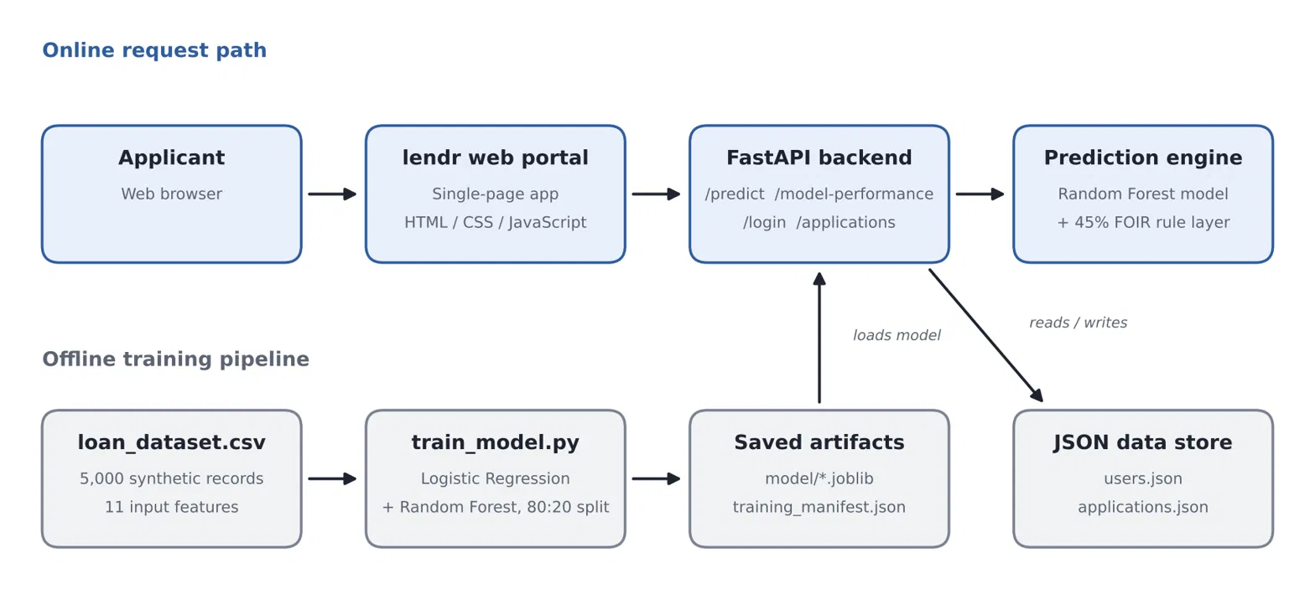
Architecture Diagram
The web portal sends applicant details to the FastAPI backend, which loads the saved Random Forest model and feature columns, computes EMI and DTI, applies the 45% FOIR rule and returns the decision, risk score and explanation. Applications and users are stored in JSON files. The training pipeline runs offline on the synthetic dataset.

Slide 12
Dataset and Feature Engineering
5,000 synthetic records (generated by generate_dataset.py); 3,773 approved and 1,227 rejected.
Train/test split is 4,000/1,000 (80:20, stratified).
11 model inputs: gender, married, dependents, education, self-employed, applicant income, co-applicant income, loan amount (₹ thousands), term (months), credit history, property area.
Pre-processing: fill missing values, label-encode categories, save feature columns and encode maps.
Replace the engineered-features line with: “Derived at prediction time (not model inputs): EMI, DTI/FOIR, Loan-to-Income.”
The synthetic-data limitation line stays correct.

Slide 13
Modules and Module Description
Module | Description
Data Pre-processing | Fills missing values, encodes categorical features, splits data 80:20 (stratified)
Feature Engineering | Computes EMI (8.5% reducing balance), DTI/FOIR and loan-to-income; applies the 45% FOIR rule
Model Training | Trains Logistic Regression and Random Forest and saves the best model
Evaluation | Accuracy, precision, recall, F1, ROC-AUC, confusion matrix, feature importance
Backend (FastAPI) | Loads the saved model; /predict returns decision, risk score and explanation; /model-performance returns metrics; login and application history
Frontend (webpage) | Single-page app: Overview, Applications, EMI Planner, Eligibility, Model Performance and more

Slide 14
Algorithm
Machine learning classification with a baseline model, a production model and a rule layer.
Logistic Regression: a linear baseline trained on standardised features.
Random Forest: 500 trees (max depth 16, class-balanced) on bootstrap samples with random features; majority vote reduces variance. This is the production model.
Underwriting rule layer: reject if credit history is 0 or DTI is above 50%; sharply reduce the approval probability when DTI exceeds the 45% FOIR cap; otherwise approve when probability is at least 0.5.
Output: approval decision, risk score, key factors and explanation shown in the portal.
Feature importance shows which inputs drive the decision.

Slide 15
Implementation
The system is implemented in Python and JavaScript. generate_dataset.py creates the synthetic data, and train_model.py pre-processes it, trains and compares the models, and saves the model, feature columns, metrics and evaluation plots. A FastAPI server (uvicorn, port 8000) loads the saved model, serves the /predict and /model-performance endpoints, and also serves the front end. The web portal is a single HTML page with a dashboard, a loan application form, application history, EMI, eligibility and payoff planners, and a Model Performance page. verify_connection.py runs five automated checks (dataset integrity, dataset hash, model concordance, EMI maths and metric match).

Slide 16
Results and Discussion
Metric | Production Ensemble
Accuracy | 95.50%
Precision | 97.84%
Recall | 96.16%
F1-score | 96.99%
ROC-AUC | 98.32%
Tested on 1,000 unseen records after training on 4,000.
High recall (96.16%): only 29 of 755 creditworthy applicants were rejected.
ROC-AUC 98.32%: the model ranks applicants by risk very well.
Dataset is synthetic, so real-world performance may differ.

Slide 17
Results: Model Benchmark
 | Accuracy | Precision | Recall | F1 | ROC-AUC
Random Forest | 95.50% | 97.84% | 96.16% | 96.99% | 98.32%
Logistic regression | 94.00% | 98.33% | 93.64% | 95.93% | 98.14%

Slide 18
Results: Baseline vs Ensemble
Random Forest gains over Logistic Regression: +1.50 accuracy, +2.52 recall, +1.06 F1 and +0.18 ROC-AUC.
Precision is 0.49 lower (97.84% vs 98.33%).
Random Forest is chosen because it misses fewer creditworthy applicants and has the better F1.

Slide 19
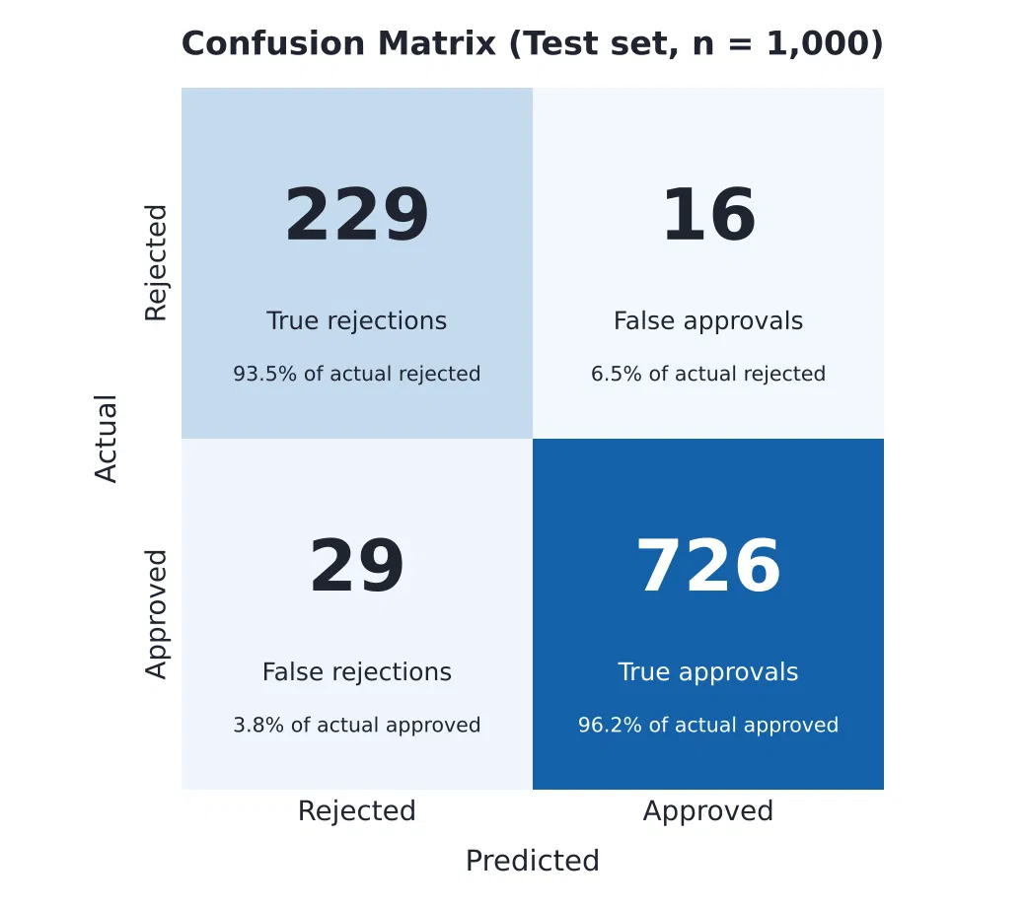
Results: Confusion Matrix
Measure | Value
Sensitivity (recall) | 96.16%
Specificity | 93.47%
False-positive rate | 6.53%
False-negative rate | 3.84%
Neg. predictive value | 88.76%
726 true approvals, 229 true rejections, 16 false approvals and 29 false rejections (n = 1,000). Most errors are false rejections (29 vs 16), so some good applicants are turned away, which the 45% FOIR rule and manual review can help catch.

Slide 20
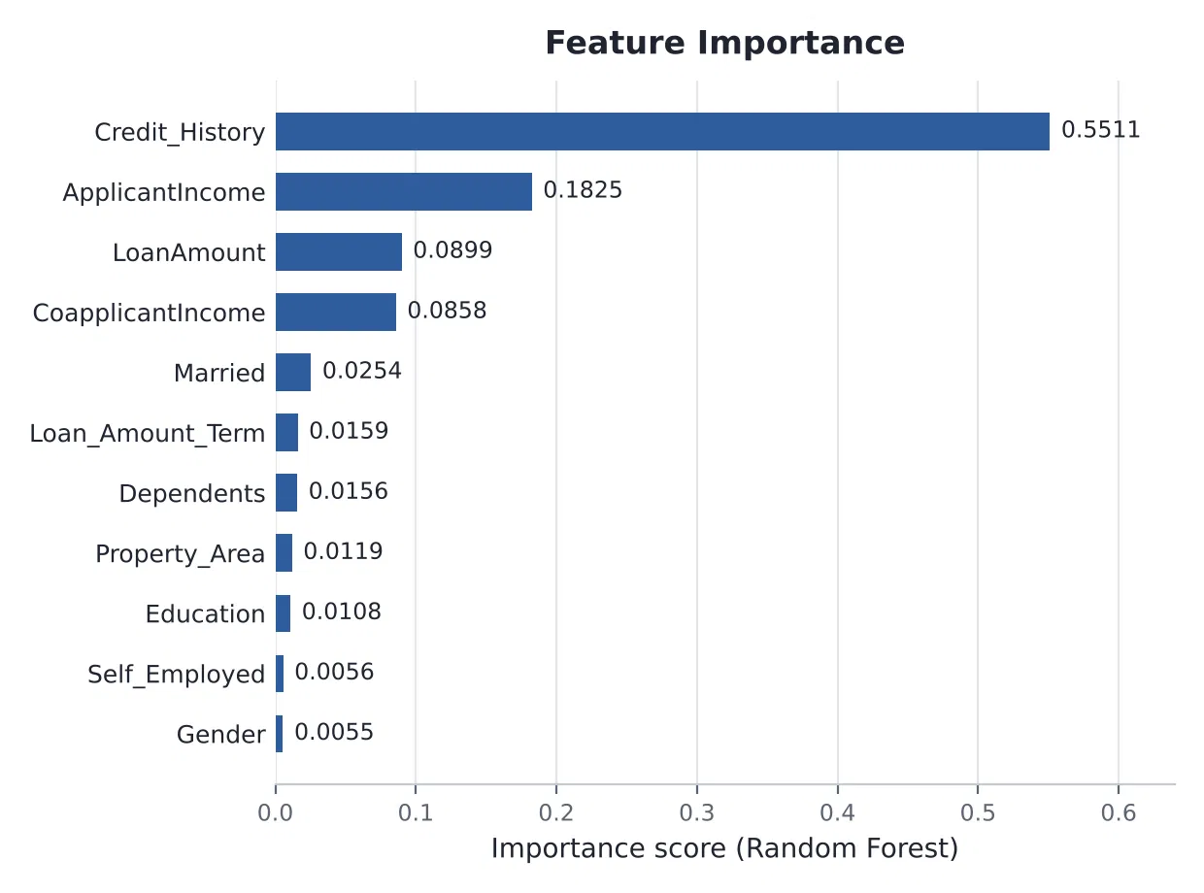
Results: Feature Importance
Credit_History is the strongest predictor (0.5511).
ApplicantIncome (0.1825), LoanAmount (0.0899) and CoapplicantIncome (0.0858) follow.
Credit_History + ApplicantIncome ≈ 73% of total importance.
Gender and Self_Employed are below 0.006.

Slide 21
Comparison with Existing Work
Aspect | Existing (manual / Streamlit prototype) | Proposed system
Decision | Manual review by an officer; single script | Automated Random Forest prediction plus 45% FOIR rule
Risk evidence | Subjective, no measurable score | 98.32% ROC-AUC, feature importance, risk score and explanation
Consistency | Varies between officers | Same model applied to every applicant
Features | Raw application fields | Raw fields plus EMI, DTI and Loan-to-Income computed for the FOIR rule
Architecture | Interface and logic in one script | FastAPI backend + Web portal
Integration | Hard to connect to other systems | REST API (/predict, /model-performance)

Slide 22
Conclusion
This project built an automated Loan Approval and Risk Assessment system. After pre-processing a synthetic dataset of 5,000 applications, Logistic Regression and Random Forest were benchmarked, and the Random Forest was deployed as the production model, reaching 95.50% accuracy, 96.16% recall, 96.99% F1 and 98.32% ROC-AUC on 1,000 unseen records. Credit history and applicant income are the most influential features. The model is combined with a 45% FOIR underwriting rule and deployed through FastAPI and a web portal, giving instant, consistent decisions with explanations. Because the data is synthetic, results should be confirmed on real loan data, and the system is a decision-support tool for loan officers.

Slide 23
Future Work
Validate and retrain the model on real-world loan data and report cross-validation results. Add explainability (SHAP or LIME) so every decision can be explained, and audit fairness on sensitive attributes. Reduce false rejections and false approvals using cost-sensitive learning or threshold tuning. Replace the JSON-file storage with a database, add salted password hashing or JWT sessions, verify Google sign-in tokens on the server, and add audit logs and an admin view. Containerise the backend with Docker, deploy to the cloud (a Render Procfile is already included) and monitor the model for drift. Integrate document verification, fraud detection and credit bureau APIs, and build a mobile application.

Slide 24
References (Research Papers)
[1] L. Breiman, “Random Forests,” Machine Learning, vol. 45, no. 1, pp. 5–32, 2001.
[2] F. Pedregosa et al., “Scikit-learn: Machine Learning in Python,” JMLR, vol. 12, pp. 2825–2830, 2011.
[3] D. J. Hand and W. E. Henley, “Statistical Classification Methods in Consumer Credit Scoring: A Review,” J. R. Stat. Soc. A, vol. 160, no. 3, pp. 523–541, 1997.
[4] A. E. Khandani, A. J. Kim and A. W. Lo, “Consumer credit-risk models via machine-learning algorithms,” J. Banking & Finance, vol. 34, no. 11, pp. 2767–2787, 2010.
[5] S. Lessmann, B. Baesens, H.-V. Seow and L. C. Thomas, “Benchmarking state-of-the-art classification algorithms for credit scoring,” EJOR, vol. 247, no. 1, pp. 124–136, 2015.
[6] T. Chen and C. Guestrin, “XGBoost: A Scalable Tree Boosting System,” Proc. KDD, pp. 785–794, 2016.
[7] N. V. Chawla et al., “SMOTE: Synthetic Minority Over-sampling Technique,” JAIR, vol. 16, pp. 321–357, 2002.
[8] T. Fawcett, “An introduction to ROC analysis,” Pattern Recognition Letters, vol. 27, no. 8, pp. 861–874, 2006.
[9] L. C. Thomas, “A survey of credit and behavioural scoring,” Int. J. Forecasting, vol. 16, no. 2, pp. 149–172, 2000.
[10] T. Hastie, R. Tibshirani and J. Friedman, The Elements of Statistical Learning, 2nd ed., Springer, 2009.

Slide 25
References (Resources)
Scikit-learn Documentation, “Machine Learning in Python.” https://scikit-learn.org/
Kaggle, “Loan Prediction Dataset.” https://www.kaggle.com/
IBM, “Machine Learning and Data Analytics.” https://www.ibm.com/topics/machine-learning
Reserve Bank of India (RBI), “Guidelines and Information on Banking and Credit.” https://www.rbi.org.in/
Python Software Foundation, “Python Documentation.” https://docs.python.org/3/
Google Developers, “Machine Learning Crash Course.” https://developers.google.com/machine-learning/crash-course

